Slide 1
Employee Management System Full Stack Project Overview

Slide 2
Project Structure
Backend: Node.js, Express, SQLite
Frontend: React (Vite)
Authentication: JWT, RBAC
Features: Add, Search, View, Delete Employees

Slide 3
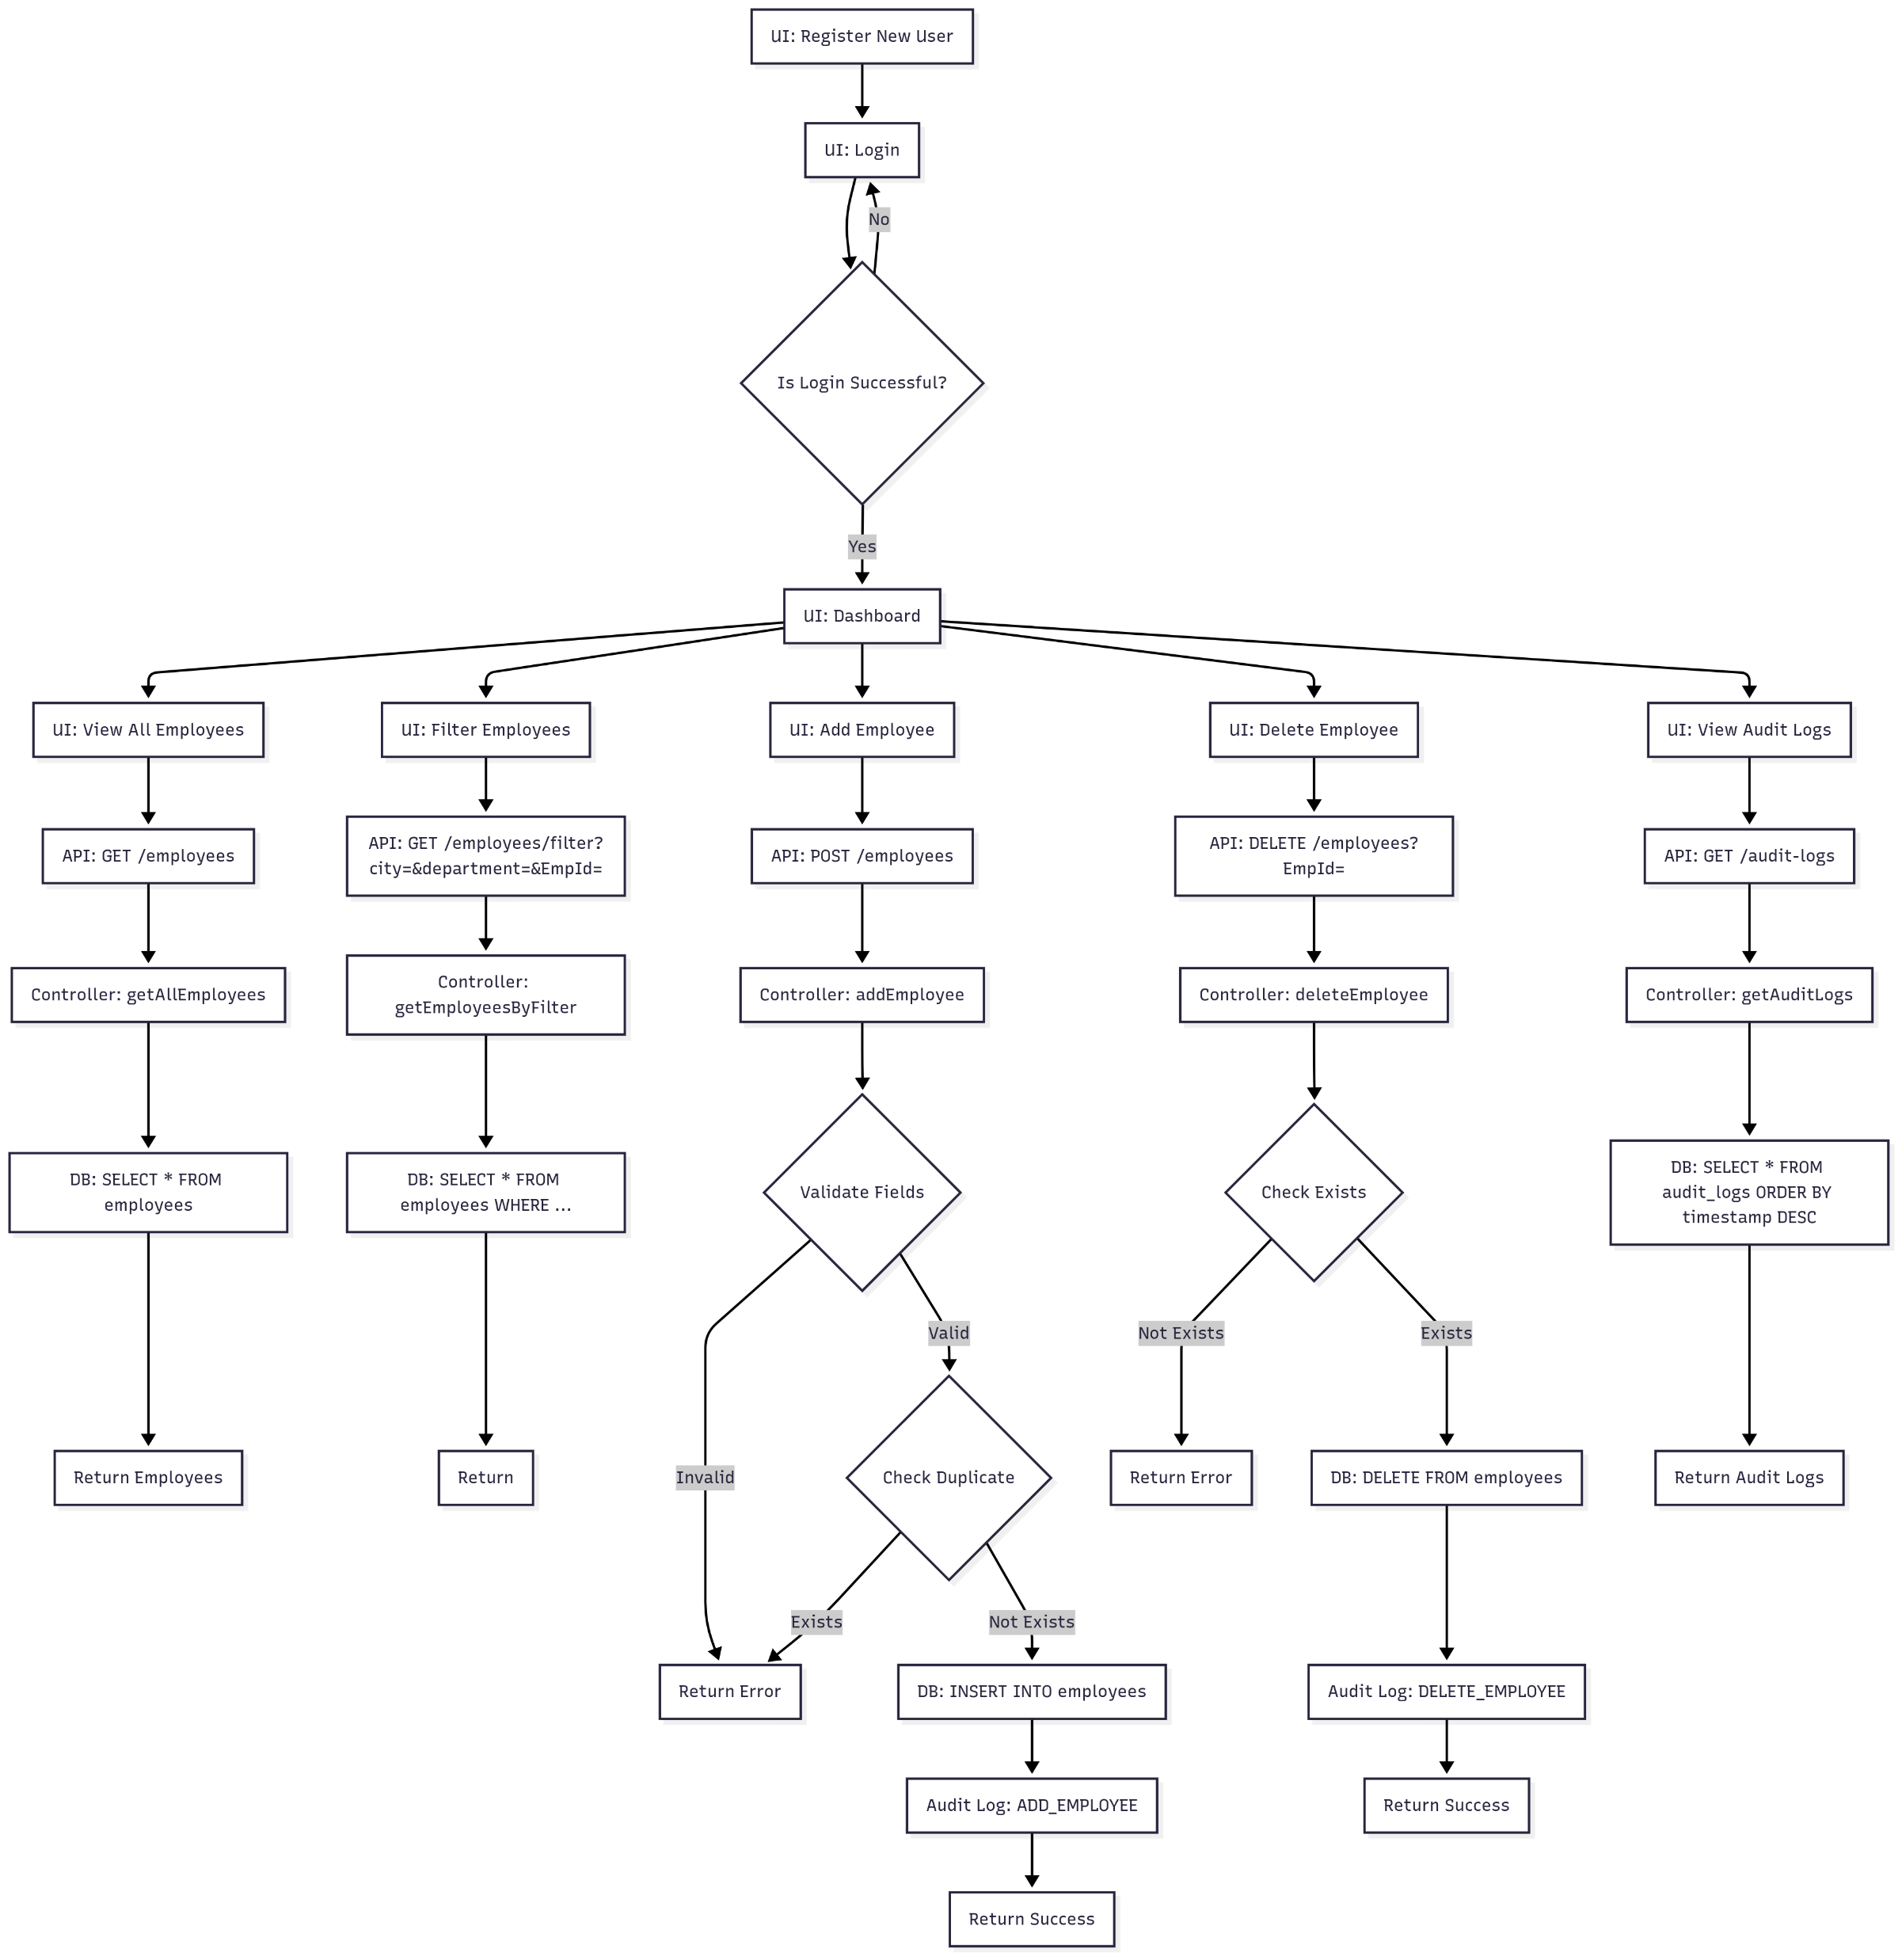
Flow Chart of API Routes

Slide 4
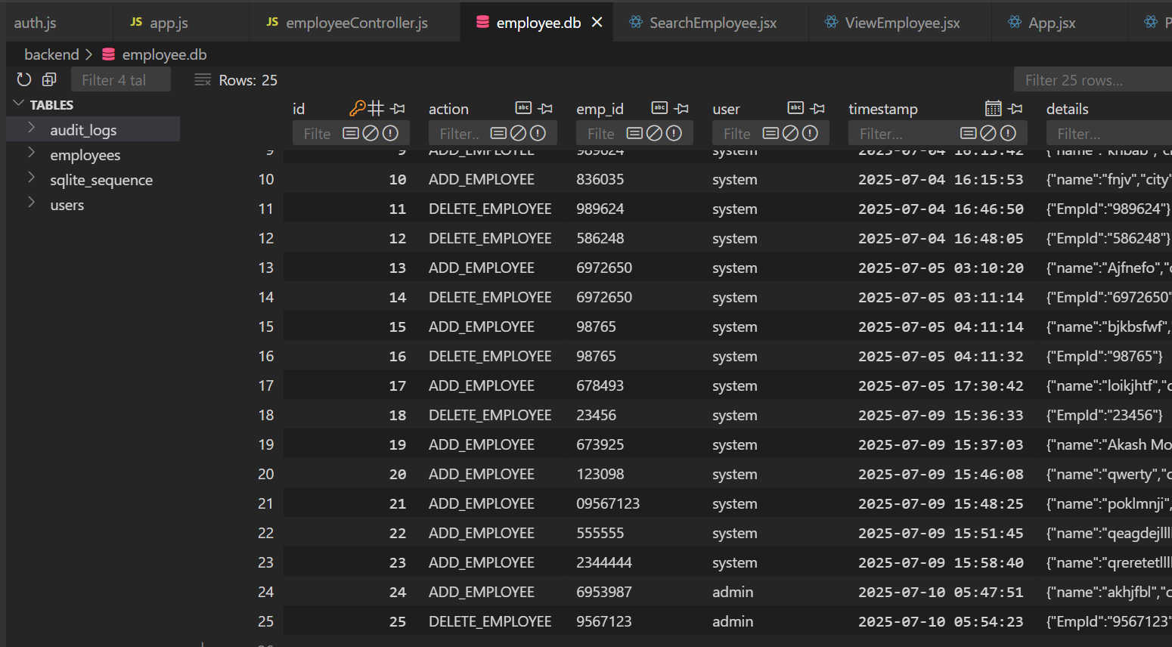
Database
Tables:
employees (EmpId, name, city, department)
users (id, username, password, role)
audit_logs (id, action, emp_id, user, timestamp, details)
Purpose:
Store employee data, user credentials/roles, and audit logs for actions.

Slide 5
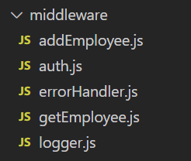
Middleware
CORS: Allows frontend-backend communication.
JWT Authentication: Protects routes, checks user identity.
Role-based Authorization: Only admins can delete employees.
Logger & Error Handler: Logs requests and handles errors globally.
Add and view handler: Handles the error scenarios of null and invalid input requests

Slide 6
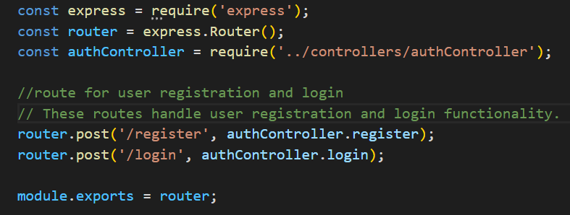
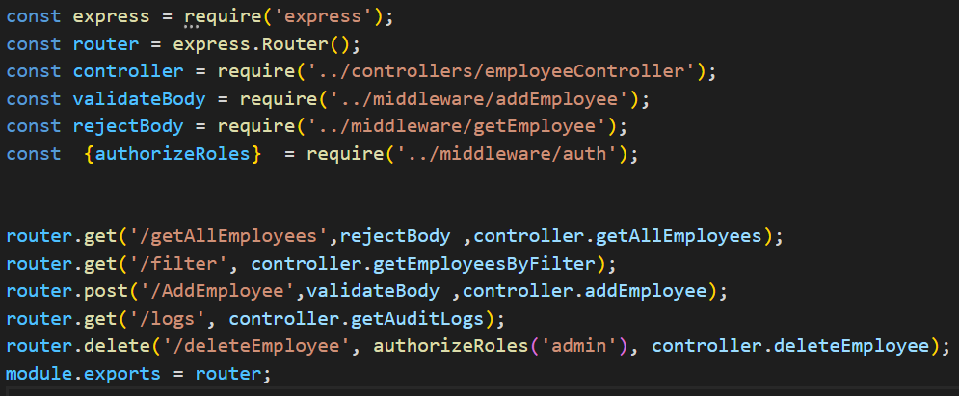
Routes
Auth:
POST /api/auth/register — Register user
POST /api/auth/login — Login user
Employees (Protected):
GET /api/employees/getAllEmployees
GET /api/employees/filter
POST /api/employees/AddEmployee
DELETE /api/employees/deleteEmployee
GET /api/employees/logs (Audit logs)

Slide 7
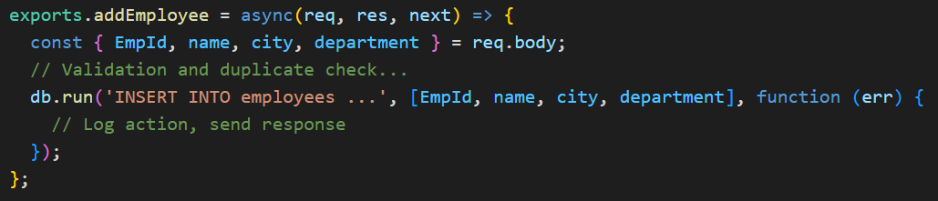
Controllers
Add Controller
Other Controllers:
getAllEmployees
getEmployeesByFilter
deleteEmployee
getAuditLogs

Slide 8
Authentication & RBAC
JWT Authentication:
First User login with Credentials
On login, user receives a JWT token.
Token is sent in Authorization header for protected routes.
RBAC:
Only users with admin role can delete employees.
All CRUD routes require authentication.

Slide 9
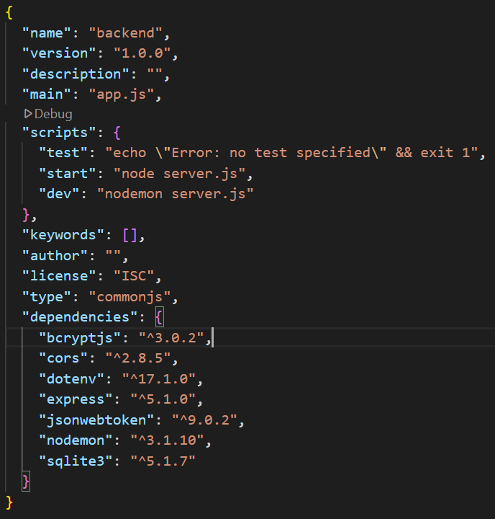
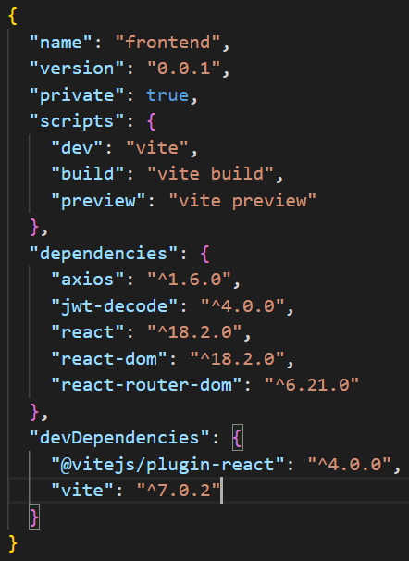
Backend and Frontend Package.json

Slide 10
Summary
Modular backend: controllers, middleware, routes
Secure: JWT authentication, RBAC
Clean React UI (Vite)
Audit logging for all actions
GitHub Link: https://github.com/aakashmondal6/EmployeeManagementBackend.git

